Slide 1
Splinters

Slide 2
Topics
What Is a Splinter?
Standard Splinters
Splinters for the Majors
Splinters for the Minors
Responding to Partner’s Splinter

Slide 3
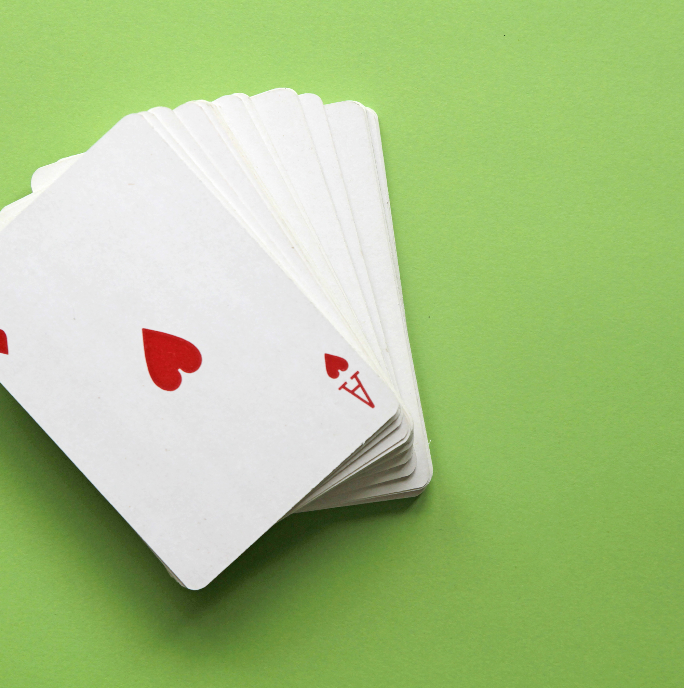
What Is a Splinter?
A bid that shows both:
> Shortness
> Support for partner’s suit (usually 4 card support for a major or 5 for a minor)

Slide 4
Standard Splinters
Can be made by either the opener or the responder
Made by jumping two levels and bidding your singleton or void
As responder, DON’T splinter with big hands. Good ranges are 9-11, 10-12, or 9-12 (partnership agreement)
DON’T splinter an Ace
DO splinter with a hand that wants to be in game, but no higher
Partner with a good hand can still go on to pursue slam

Slide 5
Splinters for the Majors
By responder: 1S – 4C shows:
> 4-card support for Spades
> a singleton or void in Clubs
> a hand that is interested in game opposite a minimum opener

Slide 6
Splinters for the Majors
By opener: 1D - 1S – 4C shows:
> 4-card support for Spades
> a singleton or void in Clubs
> a hand that wants to be in game opposite a minimum response

Slide 7
Let’s Look at Some Hands
Responder’s hand:
  Kxxx
  AJx
  x
  KT9xx
  Partner has opened 1S
  The auction goes 1S – 4D
Opener’s hand:
  x
  AQxx
  AKxxx
  QJ9
  This hand opens 1D
  The auction goes 1D – 1H – 3S

Slide 8
Some Hands That Shouldn’t Splinter
Responder’s hand:
  Kxxx
  Axxx
  x
  JTxx
  This hand is not good enough to insist on game
Responder’s hand:
  AQxx
  AKQx
  x
  QTxx
  This hand is too good to splinter

Slide 9
Splinters for the Minors
The same general rules apply
As responder, you would usually want 5-card support for a minor suit because partner may open with only 3 or 4
Your values should be a little more than for a major because you are looking for game at the 5 level

Slide 10

Here’s an Example
Responder’s hand:
  AJx
  x
  KQT9x
  KTxx
  Partner has opened 1D
  The auction goes 1D – 3H

Slide 11
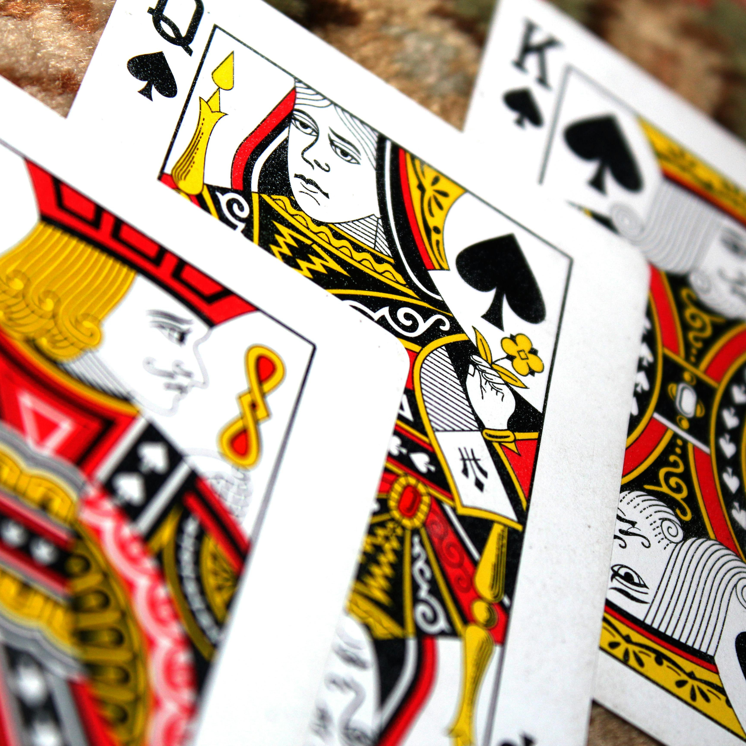
Responding to Partner’s Splinter
> Consider whether you have the values to pursue a slam
> If partner splinters in a minor, consider whether you can play 3NT before settling for game in the minor

Slide 12
Let’s Look at Some Hands
Opener’s hand:
  KQxxx
  Ax
  xxx
  AKx
  The auction goes 1S – 4D
  Opener decides to investigate slam
Opener’s hand:
  KQxxx
  Ax
  AKx
  xxx
  The auction goes 1S – 4D
  Opener signs off in game

Slide 13
Let’s Look at Some Hands
Responder’s hand:
  KQxxx
  x
  xxxx
  Kxx
  The auction goes 1H - 1S – 4D
  Responder decides to investigate slam
Responder’s hand:
  KQxxx
  x
  Kxx
  xxxx
  The auction goes 1H - 1S – 4D
  Responder signs off in game

Slide 14
Let’s Look at Some Hands
Opener’s hand:
  KQxx
  Axx
  Jxxx
  Qx
  The auction goes 1D – 3H
  Opener decides 3NT is not likely and bids 5D
Opener’s hand:
  Kxx
  KQTx
  Axxx
  xx
  The auction goes 1D – 3H
  Opener decides to bid 3NT with his heart values

Slide 15
Let’s Look at Some Hands
Opener’s hand:
  KQx
  xxxx
  AJxx
  Ax
  The auction goes 1D – 3H
  Opener decides to pursue slam in diamonds

